Slide 1
Create and use analytics reports with Power BI
Notes:
Link: https://docs.microsoft.com/en-us/learn/modules/get-started-with-power-bi/

Slide 2
Agenda
Get started with Power BI
Get data with Power BI Desktop
Create reports with Power BI and Dataverse for Teams

Slide 3

Get started with Power BI

Slide 4
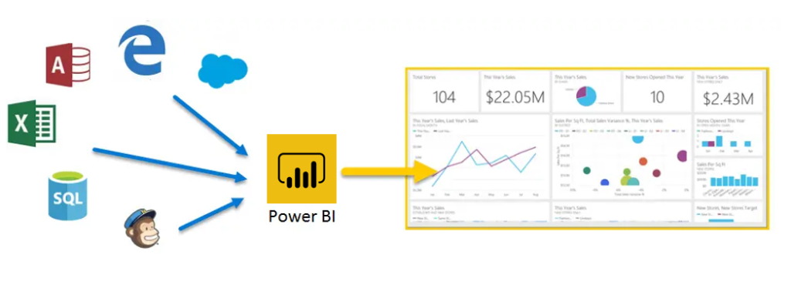
Introduction
Microsoft Power BI is a collection of software services, apps, and connectors that work together to turn your unrelated sources of data into coherent, visually immersive, and interactive insights
Notes:
Microsoft Power BI is a collection of software services, apps, and connectors that work together to turn your unrelated sources of data into coherent, visually immersive, and interactive insights. Whether your data is a simple Microsoft Excel workbook, or a collection of cloud-based and on-premises hybrid data warehouses, Power BI lets you easily connect to your data sources, visualize (or discover) what's important, and share that with anyone or everyone you want.
Power BI can be simple and fast, capable of creating quick insights from an Excel workbook or a local database. But Power BI is also robust and enterprise-grade, ready not only for extensive modeling and real-time analytics, but also for custom development. Therefore, it can be your personal report and visualization tool, but can also serve as the analytics and decision engine behind group projects, divisions, or entire corporations.
If you're a beginner with Power BI, this module will get you going. If you're a Power BI veteran, this module will tie concepts together and fill in the gaps.

Slide 5
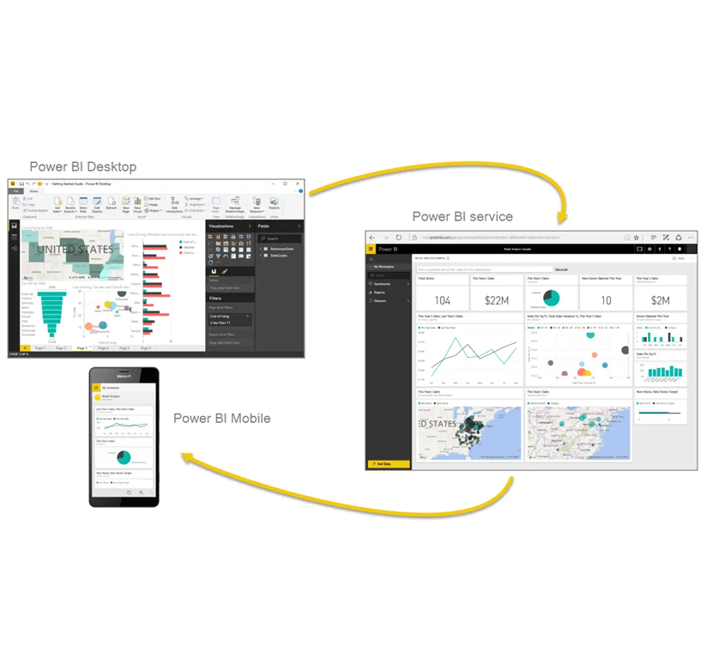
Common flow of work in Power BI
Report is created in Power BI Desktop
Report is published to the Power BI service
Report is shared and consumed on Power BI Mobile
Notes:
Power BI consists of a Microsoft Windows desktop application called Power BI Desktop, an online SaaS (Software as a Service) service called the Power BI service, and mobile Power BI apps that are available on any device, with native mobile BI apps for Windows, iOS, and Android.
These three elements-Desktop, the service, and Mobile apps-are designed to let people create, share, and consume business insights in the way that serves them, or their role, most effectively.
A common flow of work in Power BI begins in Power BI Desktop, where a report is created. That report is then published to the Power BI service and finally shared, so that users of Power BI Mobile apps can consume the information.
It doesn't always happen that way, and that's okay. But we'll use that flow to help you learn the different parts of Power BI and how they complement each other.
Okay, now that we have an overview of this module, what Power BI is, and its three main elements, let's take a look at what it's like to use Power BI.

Slide 6
Building blocks of Power BI

Slide 7
Building blocks of Power BI
Everything you do in Microsoft Power BI can be broken down into a few basic building blocks:
Visualizations
Datasets
Reports
Dashboards
Tiles
Notes:
Everything you do in Microsoft Power BI can be broken down into a few basic building blocks. After you understand these building blocks, you can expand on each of them and begin creating elaborate and complex reports. After all, even seemingly complex things are built from basic building blocks. For example, buildings are created with wood, steel, concrete and glass, and cars are made from metal, fabric, and rubber. Of course, buildings and cars can also be basic or elaborate, depending on how those basic building blocks are arranged.
Let's take a look at these basic building blocks, discuss some simple things that can be built with them, and then get a glimpse into how complex things can also be created.
Here are the basic building blocks in Power BI:
Visualizations
Datasets
Reports
Dashboards
Tiles

Slide 8
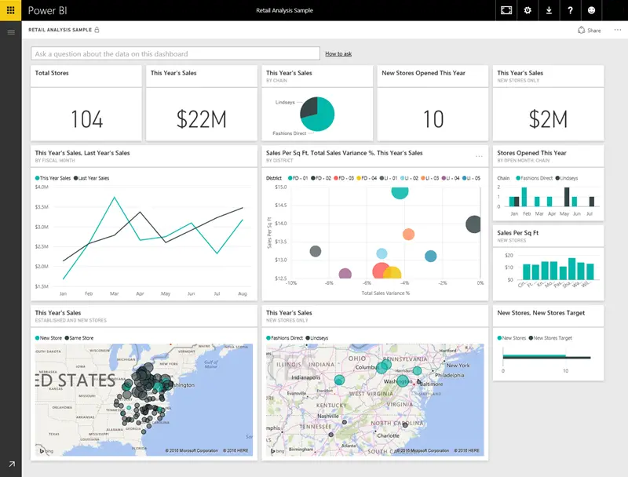
Visualizations
Visual representation of data, like a chart, a color-coded map, or other interesting things you can create to represent your data visually
Notes:
A visualization (sometimes also referred to as a visual) is a visual representation of data, like a chart, a color-coded map, or other interesting things you can create to represent your data visually. Power BI has all sorts of visualization types, and more are coming all the time. The following image shows a collection of different visualizations that were created in the Power BI service.
Visualizations can be simple, like a single number that represents something significant, or they can be visually complex, like a gradient-colored map that shows voter sentiment about a certain social issue or concern. The goal of a visual is to present data in a way that provides context and insights, both of which would probably be difficult to discern from a raw table of numbers or text.

Slide 9
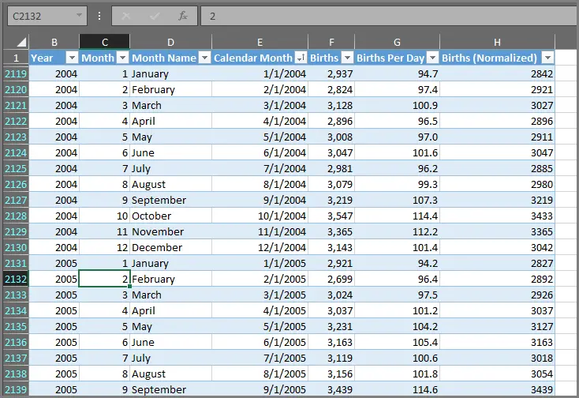
Datasets
Collection of data that Power BI uses to create its visualizations
Notes:
A dataset is a collection of data that Power BI uses to create its visualizations.
You can have a simple dataset that's based on a single table from a Microsoft Excel workbook, similar to what's shown in the following image.
Datasets can also be a combination of many different sources, which you can filter and combine to provide a unique collection of data (a dataset) for use in Power BI.
For example, you can create a dataset from three database columns, one website table, an Excel table, and online results of an email marketing campaign. That unique combination is still considered a single dataset, even though it was pulled together from many different sources.
Filtering data before bringing it into Power BI lets you focus on the data that matters to you. For example, you can filter your contact database so that only customers who received emails from the marketing campaign are included in the dataset. You can then create visuals based on that subset (the filtered collection) of customers who were included in the campaign. Filtering helps you focus your data-and your efforts.
An important and enabling part of Power BI is the multitude of data connectors that are included. Whether the data you want is in Excel or a Microsoft SQL Server database, in Azure or Oracle, or in a service like Facebook, Salesforce, or MailChimp, Power BI has built-in data connectors that let you easily connect to that data, filter it if necessary, and bring it into your dataset.
After you have a dataset, you can begin creating visualizations that show different portions of it in different ways, and gain insights based on what you see. That's where reports come in.

Slide 10
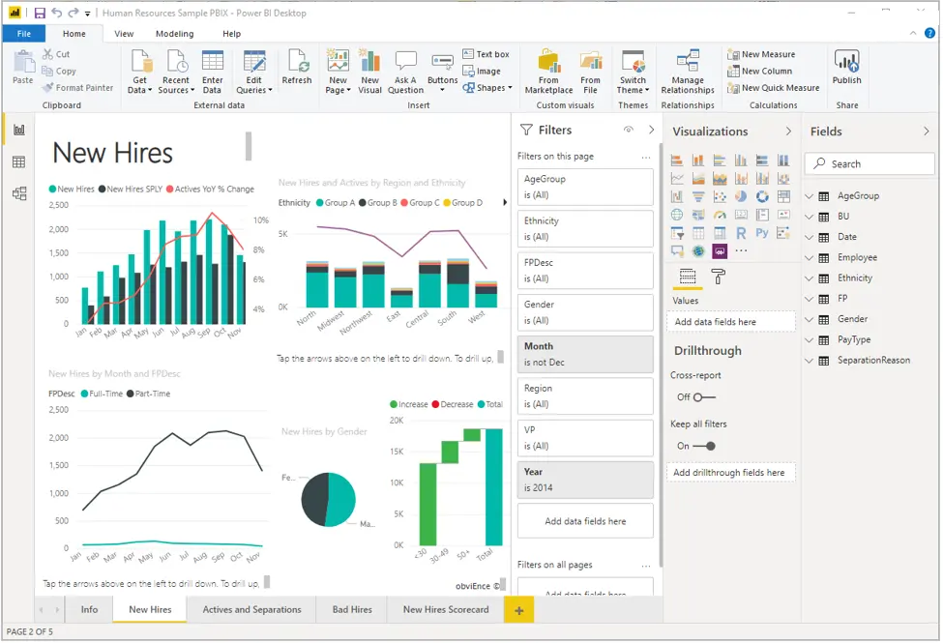
Reports
Report is a collection of visualizations that appear together on one or more pages
Notes:
In Power BI, a report is a collection of visualizations that appear together on one or more pages. Just like any other report you might create for a sales presentation or write for a school assignment, a report in Power BI is a collection of items that are related to each other. The following image shows a report in Power BI Desktop-in this case, it's the second page in a five-page report. You can also create reports in the Power BI service.
Reports let you create many visualizations, on multiple pages if necessary, and let you arrange those visualizations in whatever way best tells your story.
You might have a report about quarterly sales, product growth in a particular segment, or migration patterns of polar bears. Whatever your subject, reports let you gather and organize your visualizations onto one page (or more).

Slide 11
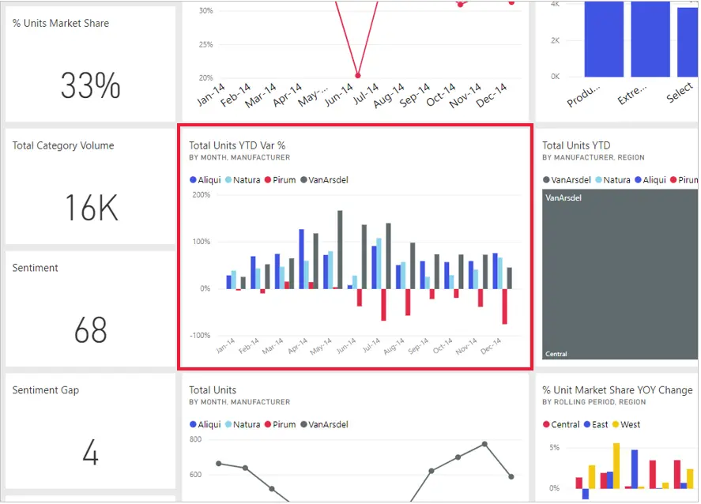
Tiles
Represents a single visualization on a report or a dashboard
Notes:
In Power BI, a tile is a single visualization on a report or a dashboard. It's the rectangular box that holds an individual visual. In the following image, you see one tile, which is also surrounded by other tiles.
When you're creating a report or a dashboard in Power BI, you can move or arrange tiles however you want. You can make them bigger, change their height or width, and snuggle them up to other tiles.
When you're viewing, or consuming, a dashboard or report-which means you're not the creator or owner, but the report or dashboard has been shared with you-you can interact with it, but you can't change the size of the tiles or their arrangement.

Slide 12

Tour and use the Power BI service

Slide 13
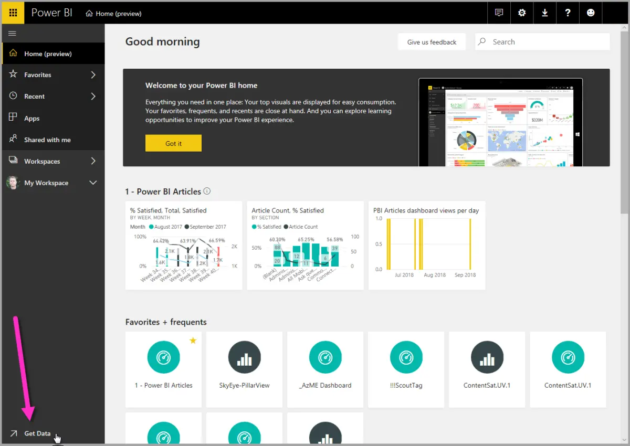
Create out-of-box dashboards with cloud services
With Power BI, connecting to data is easy
Notes:
With Power BI, connecting to data is easy. From the Power BI service, you can just select the Get Data button in the lower-left corner of the home page.

Slide 14
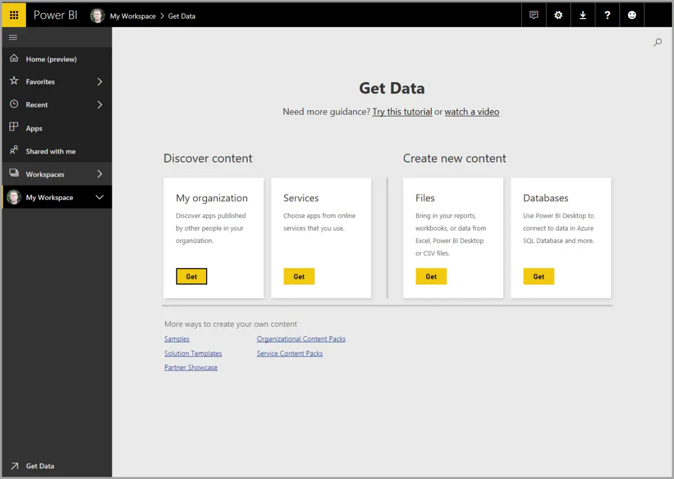
Create out-of-box dashboards with cloud services
The canvas (the area in the center of the Power BI service) shows you the available sources of data in the Power BI service
Notes:
The canvas (the area in the center of the Power BI service) shows you the available sources of data in the Power BI service. In addition to common data sources like Microsoft Excel files, databases, or Microsoft Azure data, Power BI can just as easily connect to a whole assortment of software services (also called SaaS providers or cloud services): Salesforce, Facebook, Google Analytics, and more.
For these software services, the Power BI service provides a collection of ready-made visuals that are pre-arranged on dashboards and reports for your organization. This collection of visuals is called an app. Apps get you up and running quickly, with data and dashboards that your organization has created for you. For example, when you use the GitHub app, Power BI connects to your GitHub account (after you provide your credentials) and then populates a predefined collection of visuals and dashboards in Power BI.
There are apps for all sorts of online services. The following image shows a page of apps that are available for different online services, in alphabetical order. This page is shown when you select the Get button in the Services box (shown in the previous image). As you can see from the following image, there are many apps to choose from.

Slide 15
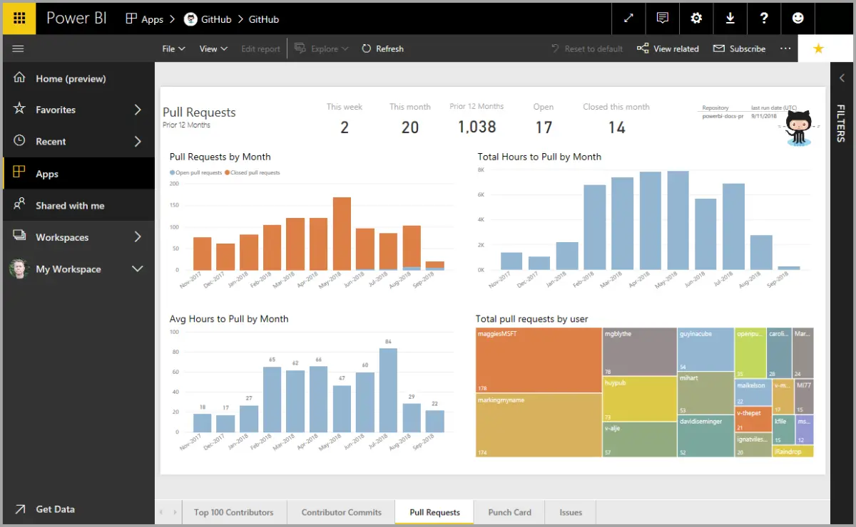
Create out-of-box dashboards with cloud services
Based on the data source selected, the predefined GitHub app dashboard appears
Notes:
After the data is loaded, the predefined GitHub app dashboard appears.

Slide 16
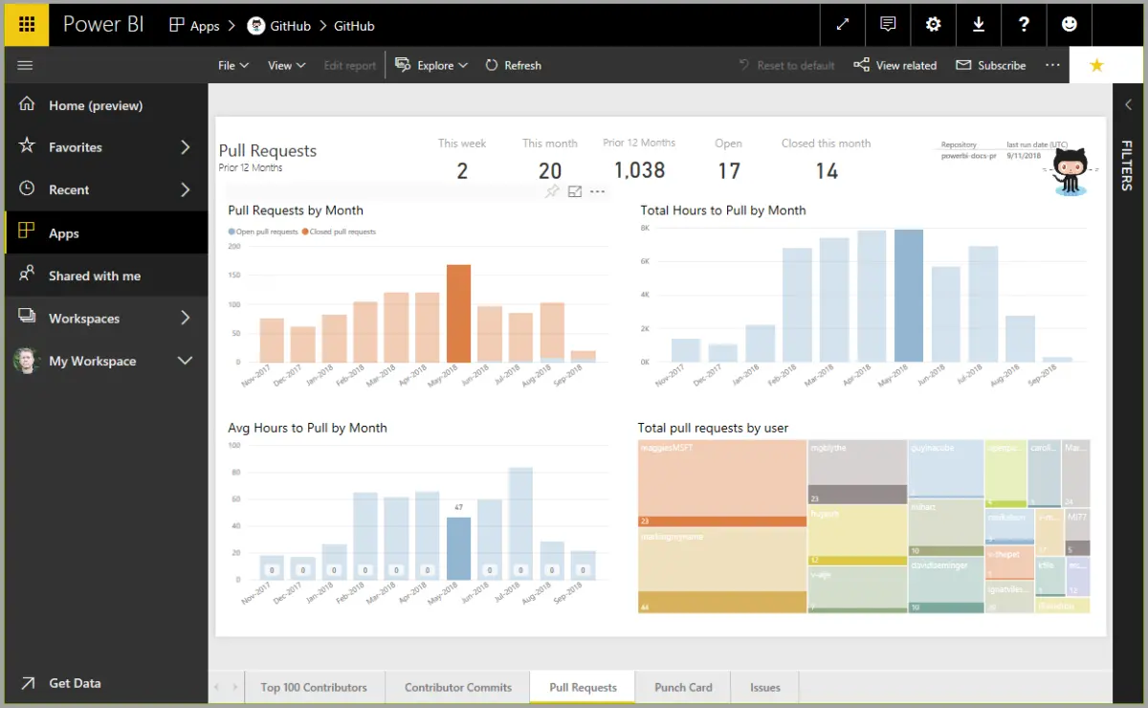
Create out-of-box dashboards with cloud services
On the dashboard, you can select any of the visuals and interact with them
Notes:
On the dashboard, you can select any of the visuals and interact with them. As you do so, all the other visuals on the page will respond. For example, when the May 2018 bar is selected in the Pull Requests (by month) visual, the other visuals on the page adjust to reflect that selection.

Slide 17
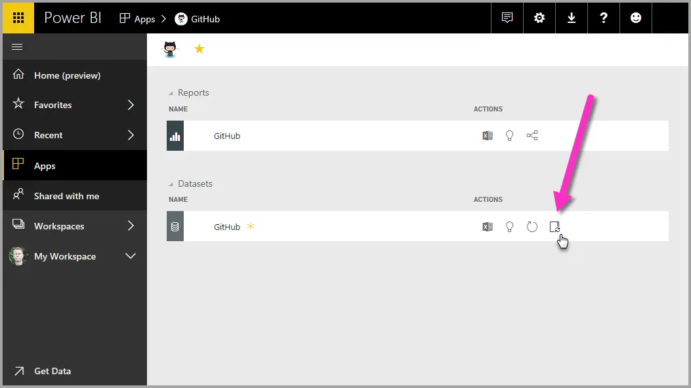
Update data in the Power BI service
You can also choose to update the dataset for an app, or other data that you use in Power BI
Notes:
You can also choose to update the dataset for an app, or other data that you use in Power BI. To set update settings, select the schedule update icon for the dataset to update, and then use the menu that appears. You can also select the update icon (the circle with an arrow) next to the schedule update icon to update the dataset immediately.

Slide 18

Get data with Power BI Desktop
Notes:
Link: https://docs.microsoft.com/en-us/learn/modules/get-data-power-bi/

Slide 19
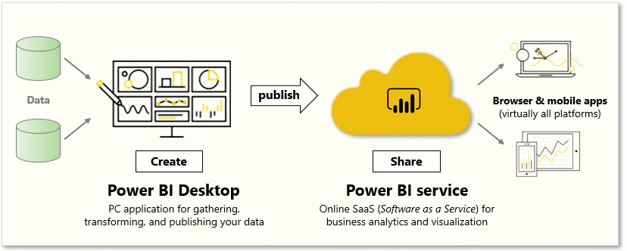
Overview of Power BI Desktop
Power BI Desktop is a free application for PCs that lets you gather, transform, and visualize your data
Notes:
Power BI Desktop is a free application for PCs that lets you gather, transform, and visualize your data. In this module, you'll learn how to find and collect data from different sources and how to clean or transform it. You'll also learn tricks to make data-gathering easier.
Power BI Desktop and the Power BI Service work together. You can create your reports and dashboards in Power BI Desktop, and then publish them to the Power BI Service for others to consume.
Video: Introduction to Power BI Desktop
[!VIDEO https://www.microsoft.com/videoplayer/embed/RE3kZ3T]
To perform the exercises in this module, you'll need to have Power BI desktop installed and have a Power BI Service account set up.

Slide 20
Download Power BI Desktop
You can download Power BI Desktop from the web or as an app from the Microsoft Store on the Windows tab
Download Strategy | Link | Notes
Windows Store App | Windows Store | Will automatically stay updated
Download from web | Download.msi | Must manually update periodically
Notes:
You can download Power BI Desktop from the web or as an app from the Microsoft Store on the Windows tab.
Please note that some students are having issues connecting to the data base when they install Power BI Desktop via the Windows Store App

Slide 21
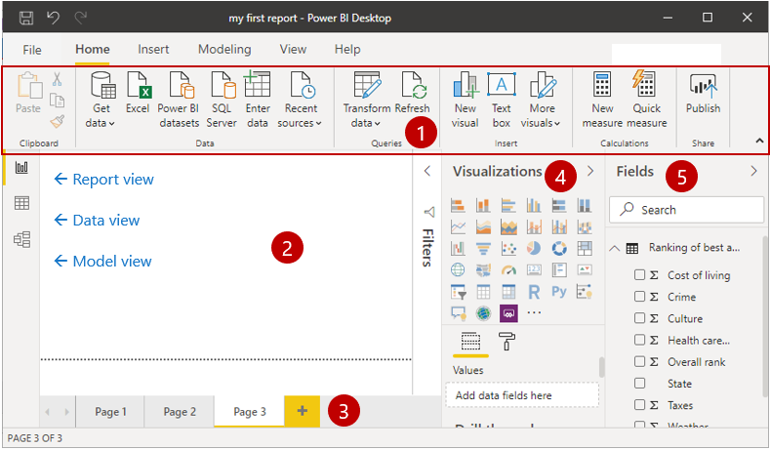
Explore the report building environment
In Power BI Desktop, you'll begin to build reports in the Report view:
Ribbon
Report view, or canvas
Pages tab
Visualizations pane
Columns pane
Notes:
Ribbon - Displays common tasks that are associated with reports and visualizations.
Report view, or canvas - Where visualizations are created and arranged. You can switch between Report, Data, and Model views by selecting the icons in the left column.
Pages tab - Located along the bottom of the page, this area is where you would select or add a report page.
Visualizations pane - Where you can change visualizations, customize colors or axes, apply filters, drag columns, and more.
Columns pane - Where query elements and filters can be dragged onto the Report view or dragged to the Filters area of the Visualizations pane.

Slide 22
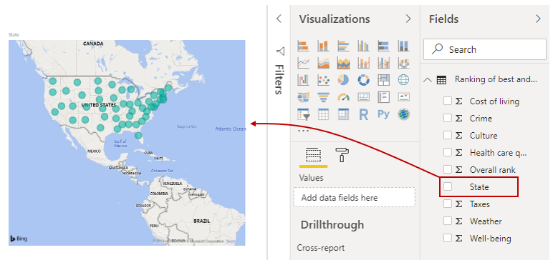
Creating visuals
To create a visual, drag a column from the columns list onto the report view
Notes:
To create a visual, drag a column from the Columns list onto the Report view.
Power BI Desktop automatically created a map-based visualization because it recognized that the State column contained geolocation data.

Slide 23
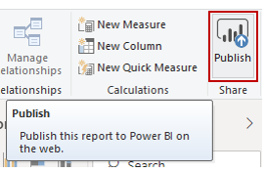
Publish a report
After creating a report with a few visuals, you're ready to publish to the Power BI service
Notes:
After creating a report with a few visuals, you're ready to publish to the Power BI service. On the Home ribbon on the Power BI Desktop, select Publish.

Slide 24
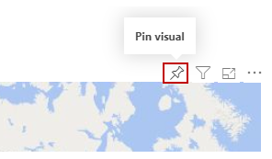
Pin a visual to a dashboard
When you view a published report in the Power BI service, you can choose the Pin icon to pin that visual to a dashboard
Notes:
When you view a published report in the Power BI service, you can choose the Pin icon to pin that visual to a dashboard.
You can choose whether to pin the visual to an existing dashboard or to create a new dashboard.
For more information, see Report View in Power BI Desktop.

Slide 25

Connect to data sources

Slide 26
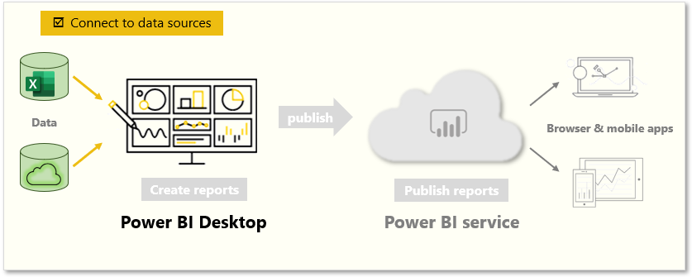
Connect to data sources
Power BI Desktop connects to many types of data sources, including local databases, worksheets, and data on cloud services
Notes:
Power BI Desktop connects to many types of data sources, including local databases, worksheets, and data on cloud services. Sometimes when you gather data, it's not quite as structured, or clean, as you want it to be. To structure data, you can transform it, meaning that you can split and rename columns, change data types, and create relationships between columns.
In this unit, you will:
Connect to data.
Import data into Power BI Desktop.
?
Video: Connecting to data sources
[!VIDEO https://www.microsoft.com/videoplayer/embed/RE3wRgY]
[!NOTE] To follow along with the examples in the videos and on this page, download the sample Access database hereand import into Power BI Desktop (Get Data > Database > Access database). If you have any issues loading the Access database, please read this article.
You can connect Power BI Desktop to many types of data sources, including on-premises databases, Microsoft Excel workbooks, and cloud services. Currently, there are about 60 Power BI-specific connectors to cloud services such as GitHub and Marketo. You can also connect to generic sources through XML, CSV, text, and ODBC. Power BI will even extract tabular data directly from a website URL.

Slide 27
Demo: Get data with Power BI desktop
Notes:
Financial Sample Workbook: https://docs.microsoft.com/en-us/power-bi/create-reports/sample-financial-download
Provide a walkthrough of the previous slides within Power BI Desktop application
https://docs.microsoft.com/en-us/learn/modules/get-data-power-bi/1-overview-power-bi-desktop

Slide 28
Embedding Power BI Visuals in Model Apps
Power BI visualizations can be embedded into personal dashboards in model driven applications
Visualizations can be embedded in two ways:
Workspace Dashboard: Entire dashboard is displayed in the Model driven app
Dashboard Tile: Tile is embedded into a model-driven application dashboard
Important: Power BI embedding must be enabled in the environment by an admin before visuals can be embedded
Notes:
Demo to students: https://docs.microsoft.com/en-us/powerapps/user/add-powerbi-dashboards

Slide 29
Create reports with Power BI for Teams

Slide 30
Introduction
Data empowers employees to make better decisions, accelerate business transformation, and grow the organization.
Import a Microsoft Dataverse dataset into Power BI.
Create a new Power BI report based on the dataset.
Edit a report.
Share a report with others.
Notes:
Data empowers employees to make better decisions, accelerate business transformation, and grow the organization. Providing business intelligence reports and dashboards offers users a way to visualize, interact, and share insights with others. Microsoft Power BI and Dataverse for Teams embeds powerful self-service reports and dashboards so that users can access your organization's data and insights without having to leave Microsoft Teams.
The learning objectives for this module are:
Import a Microsoft Dataverse dataset into Power BI.
Create a new Power BI report based on the dataset.
Edit a report.
Share a report with others.
[!NOTE] You must have the appropriate Power BI license to build and share Power BI reports. For more information about Power BI licenses, see the links that are provided in the Summary unit at the end of this module.
[!Note] For this learning module you will need to have provisioned a Dataverse for Teams environment. Please see the links that are provided in the Summary unit at the end of the module for resources on how to provision the environment.

Slide 31
Dataverse for Teams sample data
In order to show how to import data from Dataverse for Teams into Power BI, we need to first have some data in Dataverse for Teams.
Column name | Data type
Name | Text
Assembly | Number
Date | Date
Materials | Number
Package Total | Number
Printing | Number
Production Total | Number
Shipping | Number
Notes:
In order to show how to import data from Dataverse for Teams into Power BI, we need to first have some data in Dataverse for Teams. For the purposes of this learning path, we will use a table called Cost Trends that stores information captured by a Power App. You can use the Cost trends spreadsheet to upload data. Select Download and then extract the spreadsheet to your local computer. Select a Microsoft team that has a Dataverse for Teams environment then create a new table named Cost Trends with the fields and data types that are shown in the following table.
[!NOTE] Please see the links that are provided in the Summary unit at the end of the module on how to create tables in Dataverse for Teams.
[Table was here]
After creating the column names and data types in Columns, there are two ways to enter the sample data into the table. One way is to enter it directly in the table, or you can open Excel and edit the sample data.
Let move into the demo to see how its done
.

Slide 32
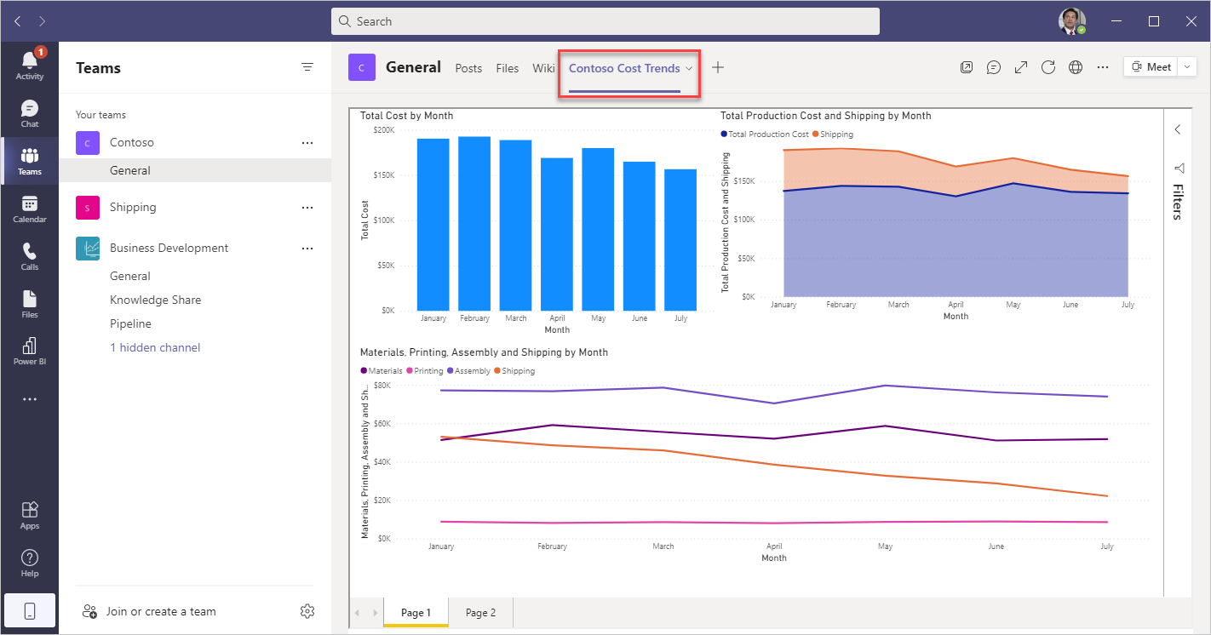
Create report in Teams
Notes:
Follow the steps in the learning path (Modules 2 to 5):
https://docs.microsoft.com/en-us/learn/modules/dataverse-teams-power-bi/

